Slide 1
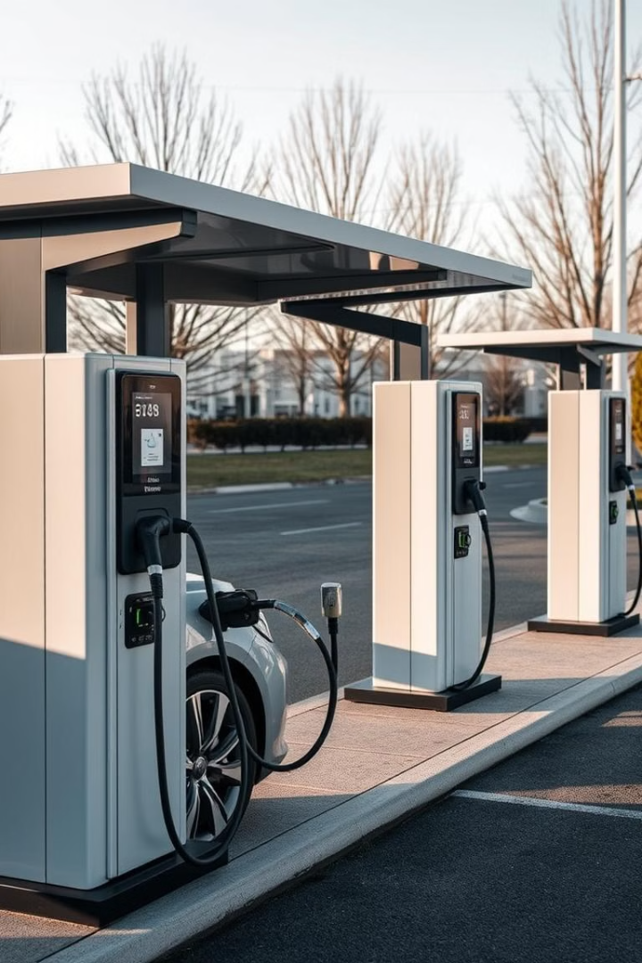
Text and Social Media Analytics ETE
Uncovering Insights on EV Adoption in India
By:
Febin Francis
2327216
MBA BA

Slide 2

Understanding the EV Adoption Landscape
The rapid growth of electric vehicles (EVs) is a significant step toward reducing carbon emissions and addressing environmental concerns. However, the adoption of EVs varies across regions and depends on multiple factors, including consumer perceptions, market offerings, infrastructure, and government policies.

Slide 3

Problem Statement: Unlocking the Barriers to EV Adoption
The global push for sustainable transportation has positioned electric vehicles (EVs) as a key solution to reduce greenhouse gas emissions and dependence on fossil fuels. However, despite advancements in EV technology, adoption rates vary significantly due to factors such as infrastructure limitations, financial concerns, and consumer perceptions. Understanding the motivations and barriers influencing consumer decisions is critical to devising effective strategies for promoting EV adoption.

Slide 4

Dataset Overview: Unveiling Consumer Perspectives on EV Adoption
The dataset is derived from a structured questionnaire designed to gather insights into consumer perspectives on electric vehicle (EV) adoption. It contains qualitative responses from individuals residing in various cities in India. The dataset comprises seven key fields, each addressing specific aspects of EV adoption.

Slide 5

Methodology: Analyzing Text Data to Uncover Insights
The study utilized a combination of text analysis techniques, including Natural Language Processing (NLP), Topic Modeling, and sentimental analysis These techniques allowed us to identify key themes, sentiment, and patterns within the data.

Slide 6
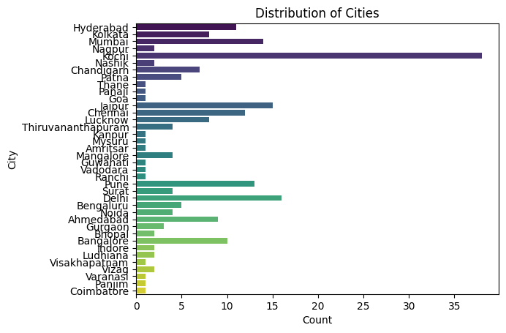
City Distribution: Where EV Adoption is Happening
City Distribution
The bar chart presents the distribution of cities of questionnaire respondents. The cities are listed on the y-axis, and the number of occurrences of each city is shown on the x-axis. The chart reveals that Kochi has the highest number of occurrences, followed by Jaipur, Mumbai, Delhi, Pune, and Hyderabad.

Slide 7
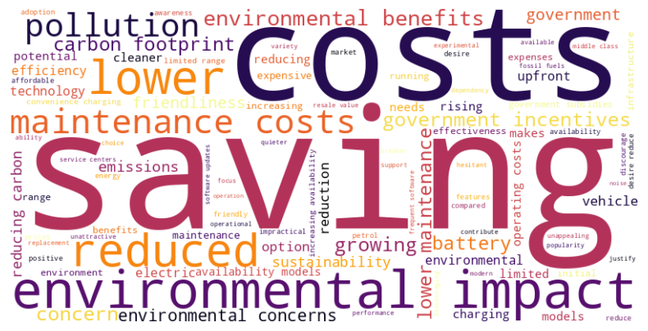
Word Cloud for Document 1: Unveiling Key Concerns
Costs
Savings
Environmental Benefits
Infrastructure
This is a prominent theme, with words like "costs," "expensive," and "upfront" suggesting concerns about the initial investment and potential running costs.
The word "saving" is central, indicating the potential long-term cost savings associated with EVs, such as lower fuel and maintenance costs.
Words like "pollution," "carbon," "environmental," and "impact" highlight the positive environmental impact of EVs.
Terms like "charging" and "availability" suggest concerns about the availability and accessibility of charging infrastructure.

Slide 8
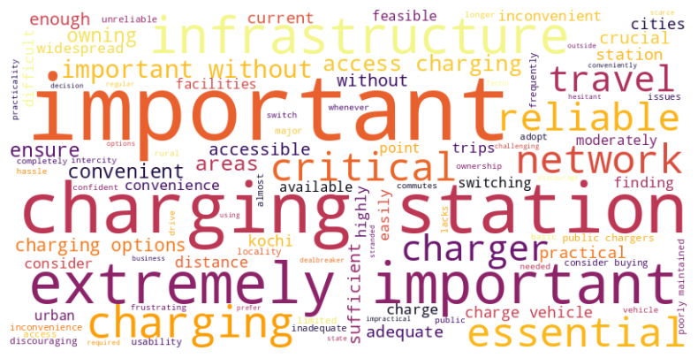
Word Cloud for Document 2: The Importance of Charging Infrastructure
Infrastructure
Convenience
Reliability
Words like "infrastructure," "facilities," "access," "network," and "stations" emphasize the crucial role of charging infrastructure in EV adoption.
Terms like "convenient," "accessible," "easy," and "hassle" indicate that users prioritize convenient charging experiences.
Words like "reliable," "adequate," and "sufficient" highlight the need for reliable charging facilities.

Slide 9

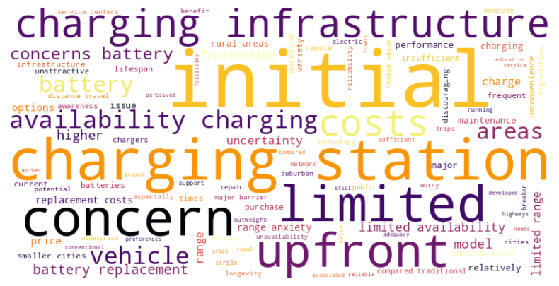
Word Cloud for Document 3: Addressing Challenges and Concerns
Charging Infrastructure
Words like "charging," "stations," and "infrastructure" emphasize the importance of a robust charging network for EV adoption. Concerns about the availability and accessibility of charging stations are highlighted.
Battery Issues
Words like "battery," "replacement," and "lifespan" suggest concerns about the lifespan and replacement costs of EV batteries. Range anxiety and limited range are also significant concerns.
Initial Costs
Words like "costs," "upfront," and "price" indicate that the initial purchase cost of EVs is a major barrier to adoption.

Slide 10
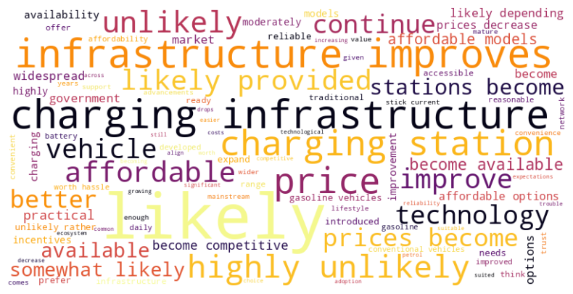
Word Cloud for Document 4: A Positive Outlook for EV Adoption
Affordability
Words like "affordable," "prices," and "decrease" indicate that EV prices are expected to become more competitive with traditional gasoline vehicles.
Infrastructure
Words like "infrastructure," "charging," and "stations" emphasize the importance of developing a robust charging infrastructure to support EV adoption.
Technology
Words like "technology" and "improve" suggest that advancements in EV technology will lead to better performance, range, and charging times.
Mainstream Adoption
Words like "mainstream," "widespread," and "likely" indicate that EVs are expected to become a common choice for consumers.

Slide 11
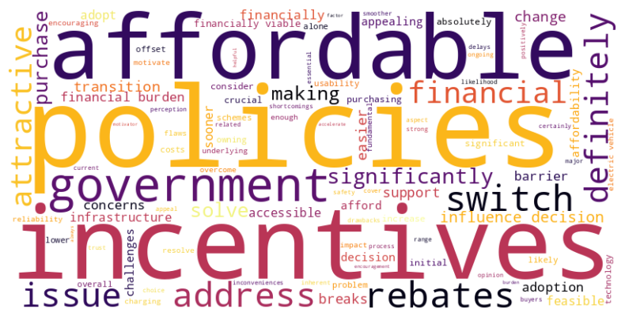
Word Cloud for Document 5: Role of government policies and incentives
Financial Incentives
Government Policies
Consumer Perception
Words like "incentives," "rebates," and "affordability" emphasize the need for financial support to make EVs more affordable for consumers.
Words like "government," "policies," and "support" highlight the crucial role of government in creating a favourable environment for EV adoption.
Words like "perception," "consider," and "influence" suggest that government policies can influence public perception of EVs and encourage adoption.

Slide 12
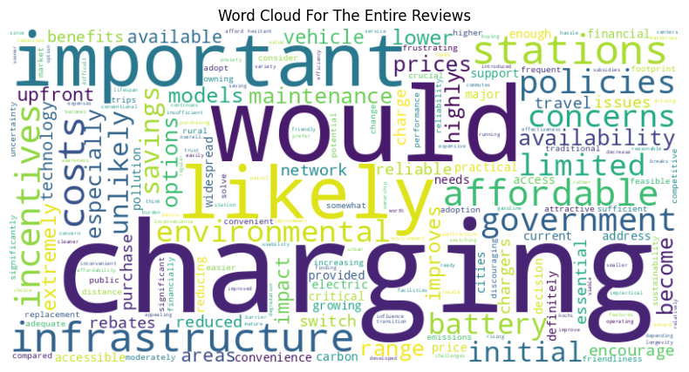
Word Cloud for Entire Response
Charging Infrastructure
Affordability
Government Policies
Environmental Benefits
This is a prominent theme, with words like "charging," "stations," and "infrastructure" emphasizing the need for a robust and accessible charging network.
Words like "affordable," "cost," and "prices" highlight the importance of making EVs more affordable to consumers.
Terms like "government," "policies," and "incentives" suggest the need for supportive government policies to encourage EV adoption.
Words like "emissions," "pollution," and "environmental" highlight the positive environmental impact of EVs.

Slide 13
Topics
Topic 1: Government Incentives and Affordability
This topic highlights the role of government policies and incentives in promoting EV adoption. It suggests that government incentives, such as rebates and tax breaks, can make EVs more affordable and encourage their purchase.
Topic 2: Initial Costs and Range Anxiety
This topic focuses on the initial cost of EVs and concerns about their range. It suggests that the high upfront cost and limited range of many EVs can be significant barriers to adoption.
Topic 3: Charging Infrastructure
This topic emphasizes the importance of charging infrastructure for EV adoption. It suggests that the availability of reliable and accessible charging stations is crucial for encouraging EV usage.
Topic 4: Battery Technology and Practicality
This topic highlights the importance of battery technology and its impact on EV practicality. It suggests that advancements in battery technology, such as improved range and faster charging times, can make EVs more appealing to consumers.
Topic 5: Future Outlook and Market Trends
This topic focuses on the future of EV adoption and market trends. It suggests that EVs are likely to become more affordable and accessible in the future, with a wider range of models available.

Slide 14
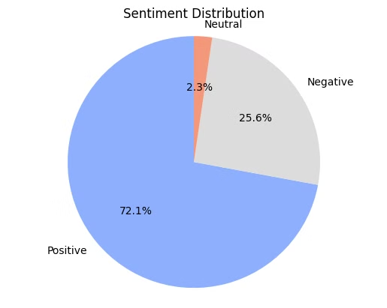
Sentiment Analysis
1. VADER (Rule Based Sentiment Analysis)
Positive Sentiment
The majority of responses (72.1%) reflect a positive outlook on EV adoption, highlighting environmental benefits, cost savings, and excitement about technology.
Negative Sentiment
A significant minority (25.6%) expressed negative sentiment, citing concerns over charging infrastructure, high costs, and limited driving range.

Slide 15
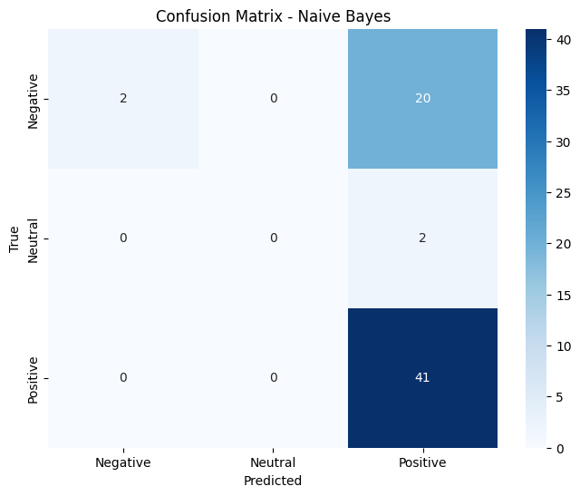
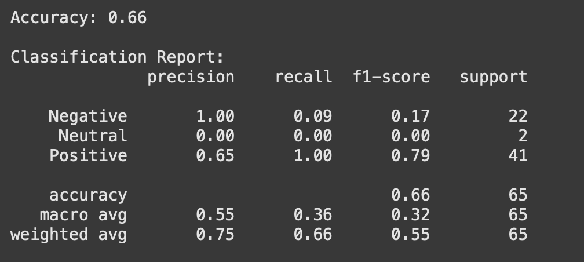
2. Naive Bayes
Accuracy
Challenges
The Naive Bayes model achieved an overall accuracy of 66%.
The model struggled with negative and neutral sentiments, primarily due to the small number of instances in these categories.

Slide 16

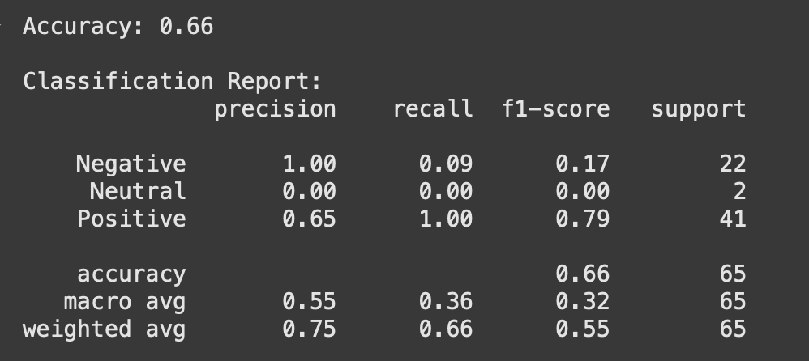
3. SVM
Accuracy
Limitations
The SVM model achieved an accuracy of 66%.
Similar to Naive Bayes, SVM faced challenges in classifying negative and neutral sentiments due to the class imbalance in the dataset.

Slide 17
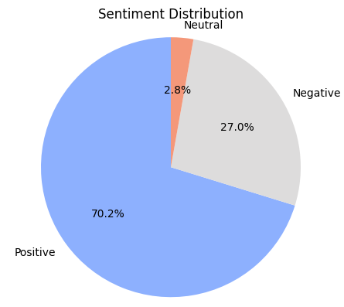
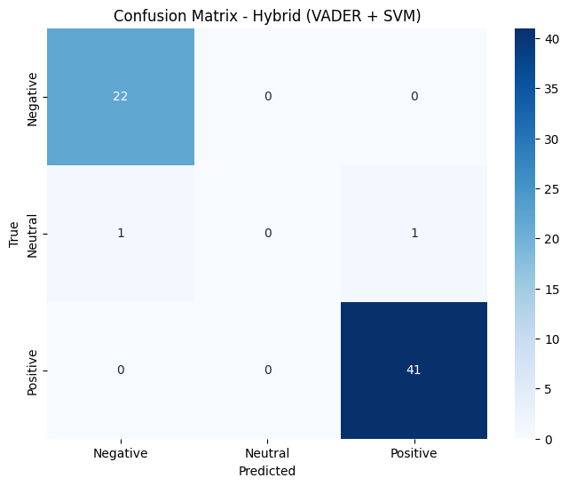
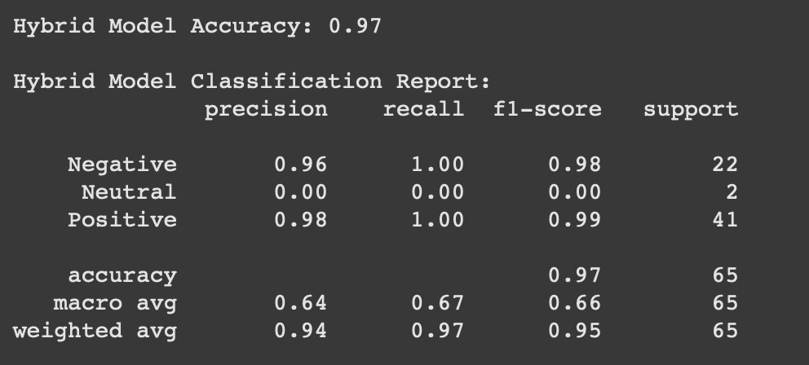
4. Hybrid Model: VADER + SVM
Accuracy
Strengths
The hybrid model achieved a significantly higher accuracy of 97%.
The combination of VADER's lexicon-based insights and SVM's classification strength led to improved performance in predicting all three sentiment classes.

Slide 18
Model Comparison: Leaderboard
Model | Accuracy
Navie Bayes | 66%
SVM | 66%
Hybrid (VADER + SVM) | 97%
Insights from the Leader board
The hybrid model's superior performance (97% accuracy) highlights the benefits of integrating rule-based and machine-learning approaches. By combining VADER's pre-classification capabilities with SVM's ability to generalize patterns, the hybrid model demonstrated a comprehensive understanding of the data.

Slide 19
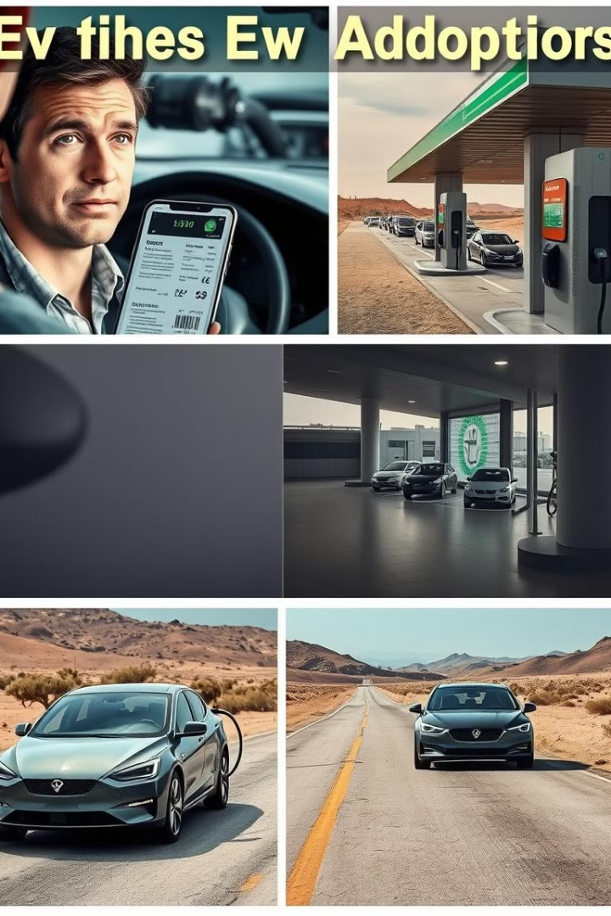
Recommendations:
1. Address Negative Sentiments
1
High Upfront Costs
2
Inadequate Charging Infrastructure
Implement subsidy programs and tax incentives to make EVs more affordable.
Expand the public charging network in urban and rural areas.
3
Limited Driving Range
Invest in R&D to improve battery technology for extended ranges.

Slide 20
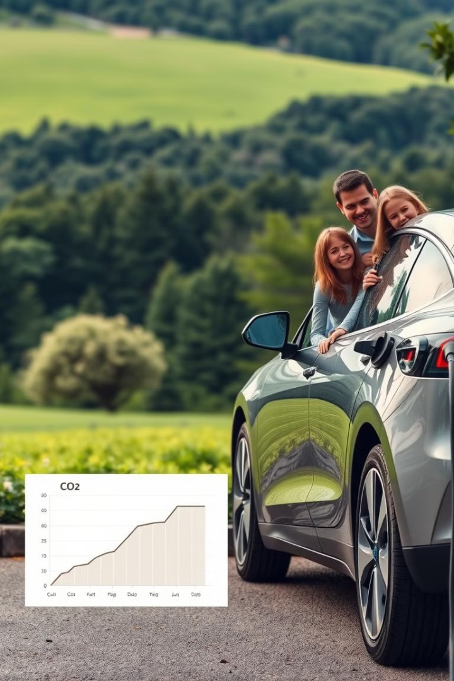
Recommendations:
2. Reinforce Positive Sentiments
1
Environmental Benefits
2
Cost Savings
Emphasize the lower operating and maintenance costs of EVs compared to traditional vehicles.
Highlight the environmental impact of EV adoption through marketing campaigns.

Slide 21
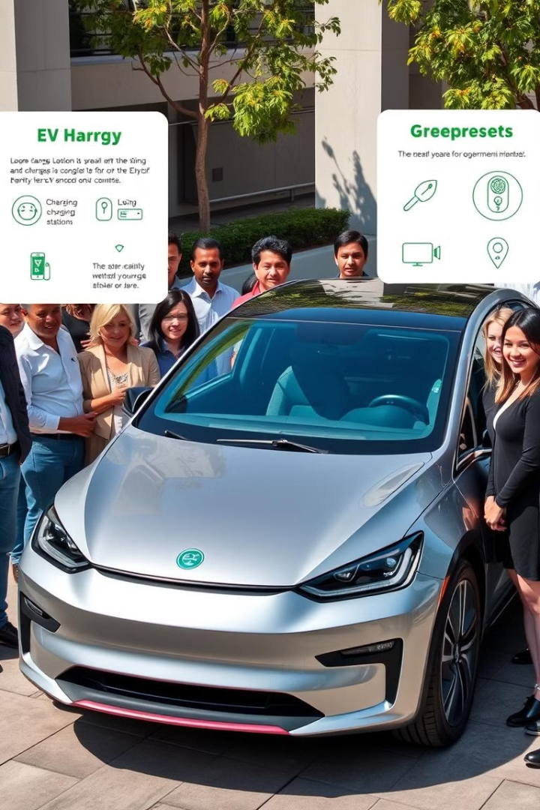
Recommendations:
3. Enhance Neutral Sentiments
1
Consumer Education
2
Test Drive Campaigns
Address knowledge gaps by providing clear, factual information about EV capabilities and incentives.
Increase consumer engagement by offering free test drive programs to experience EV benefits first-hand.

Slide 22

Conclusion: Driving Toward a Sustainable Future
This analysis provides a comprehensive study of consumer sentiment toward electric vehicle adoption. While there are significant challenges to overcome, the hybrid model's high accuracy suggests that a combined approach utilizing both rule-based and machine-learning techniques can effectively predict and understand consumer attitudes. By addressing consumer concerns and reinforcing positive perceptions, we can accelerate the transition to a more sustainable transportation future.

